Slide 1
SNMP
Simple Network Management Protocol
Chris Francois
CS 417d Fall 1998
cfrancois@acm.org

Slide 2
What is Network Management?
Basic tasks that fall under this category are:
Configuration Management
Keeping track of device settings and how they function
Fault Management
Dealing with problems and emergencies in the network (router stops routing, server loses power, etc.)
Performance Management
How smoothly is the network running?
Can it handle the workload it currently has?

Slide 3
Network Management must be...
The management interface must be...
Standardized
Extendible
Portable
The management mechanism must be...
Inexpensive
Implemented as software only

Slide 4
SNMP & Network Management History
1983 - TCP/IP replaces ARPANET at U.S. Dept. of Defense, effective birth of Internet
First model for net management - HEMS - High-Level Entity Management System (RFCs 1021,1022,1024,1076)
1987 - ISO OSI proposes CMIP - Common Management Information Protocol, and CMOT (CMIP over TCP) for the actual network management protocol for use on the internet
Nov. 1987 - SGMP - Simple Gateway Monitoring protocol (RFC 1028)
1989 - Marshall T. Rose heads up SNMP working group to create a common network management framework to be used by both SGMP and CMOT to allow for transition to CMOT
Aug. 1989 - “Internet-standard Network Management Framework” defined (RFCs 1065, 1066, 1067)
Apr. 1989 - SNMP promoted to recommended status as the de facto TCP/IP network management framework (RFC 1098)
June 1989 - IAB committee decides to let SNMP and CMOT develop separately
May 1990 - IAB promotes SNMP to a standard protocol with a recommended status (RFC 1157)
Mar. 1991 - format of MIBs and traps defined (RFCs 1212, 1215)
TCP/IP MIB definition revised to create SNMPv1 (RFC 1213)

Slide 5
Versions
Two major versions SNMPv1, SNMPv2, SNMPv3
SNMPv1 (1990) is the recommended standard
SNMPv2 (1996) has become split into:
  SNMPv2u - SNMPv2 with user-based security
  SNMPv2* - SNMPv2 with user-based security and additional features
  SNMPv2c - SNMPv2 without security
SNMPv3 (2002) has added more security.

Slide 6
What is SNMP?
SNMP is a tool (protocol) that allows for remote and local management of items on the network including servers, workstations, routers, switches and other managed devices.
Comprised of agents and managers
Agent - process running on each managed node collecting information about the device it is running on.
Manager - process running on a management workstation that requests information about devices on the network.

Slide 7
Client Pull & Server Push
SNMP is a “client pull” model
The management system (client) “pulls” data from the agent (server).
SNMP is a “server push” model
The agent (server) “pushes” out a trap message to a (client) management system

Slide 8

SNMP & The OSI Model

Slide 9
Nodes
Items in an SNMP Network are called nodes. There are different types of nodes.
Managed nodes
Typically runs an agent process that services requests from a management node
Management nodes
Typically a workstation running some network management & monitoring software
Nodes that are not manageable by SNMP
A node may not support SNMP, but may be manageable by SNMP through a proxy agent running on another machine
Nodes can be both managed nodes and a management node at the same time (typically this is the case, since you want to be able to manage the workstation that your management application is running on.)

Slide 10
Community Names
Community names are used to define where an SNMP message is destined for.
They mirror the same concept as a Windows NT or Unix domain.
Set up your agents to belong to certain communities.
Set up your management applications to monitor and receive traps from certain community names.

Slide 11
Ports & UDP
SNMP uses User Datagram Protocol (UDP) as the transport mechanism for SNMP messages
Ethernet Frame
IP Packet
SNMP Message
CRC
UDP Datagram
Like FTP, SNMP uses two well-known ports to operate:
UDP Port 161 - SNMP Messages
UDP Port 162 - SNMP Trap Messages

Slide 12
Basic Message Format
Message Length
Message Version
Message Preamble
Community String
PDU Header
SNMP Protocol Data Unit
PDU Body

Slide 13
The Three Parts of SNMP
SNMP network management is based on three parts:
SNMP Protocol
Defines format of messages exchanged by management systems and agents.
Specifies the Get, GetNext, Set, and Trap operations
Structure of Management Information (SMI)
Rules specifying the format used to define objects managed on the network that the SNMP protocol accesses
Management Information Base (MIB)
A map of the hierarchical order of all managed objects and how they are accessed

Slide 14
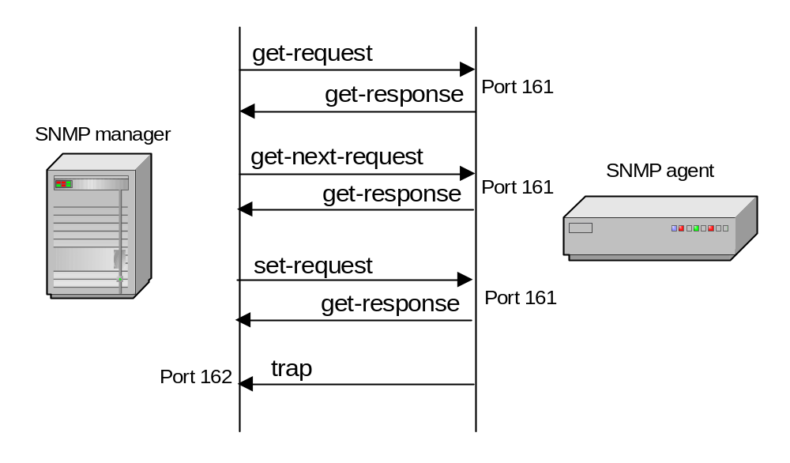
SNMP Protocol
SNMP manager and an SNMP agent communicate using the SNMP protocol
  Generally: Manager sends queries and agent responds
  Exception: Traps are initiated by agent.

Slide 15
Four Basic Operations
Get
Retrieves the value of a MIB variable stored on the agent machine
(integer, string, or address of another MIB variable)
GetNext
Retrieves the next value of the next lexical MIB variable
Set
Changes the value of a MIB variable
Trap
An unsolicited notification sent by an agent to a management application (typically a notification of something unexpected, like an error)

Slide 16
Traps
Traps are unrequested event reports that are sent to a management system by an SNMP agent process
When a trappable event occurs, a trap message is generated by the agent and is sent to a trap destination (a specific, configured network address)
Many events can be configured to signal a trap, like a network cable fault, failing NIC or Hard Drive, a “General Protection Fault”, or a power supply failure
Traps can also be throttled -- You can limit the number of traps sent per second from the agent
Traps have a priority associated with them -- Critical, Major, Minor, Warning, Marginal, Informational, Normal, Unknown

Slide 17
Trap Receivers
Traps are received by a management application.
Management applications can handle the trap in a few ways:
Poll the agent that sent the trap for more information about the event, and the status of the rest of the machine.
Log the reception of the trap.
Completely ignore the trap.
Management applications can be set up to send off an e-mail, call a voice mail and leave a message, or send an alpha-numeric page to the network administrator’s pager that says:
Your PDC just Blue-Screened at 03:46AM. Have a nice day. :)

Slide 18
Languages of SNMP
Structure of Management Information (SMI)
specifies the format used for defining managed objects that are accessed via the SNMP protocol
Abstract Syntax Notation One (ASN.1)
used to define the format of SNMP messages and managed objects (MIB modules) using an unambiguous data description format
Basic Encoding Rules (BER)
used to encode the SNMP messages into a format suitable for transmission across a network

Slide 19
SMIv1
Structure of Management Information
SMIv1 is described in RFCs 1155, 1212, 1215
These RFCs describe:
How MIB modules are defined with CCITT X.208 ASN.1 data description language
The subset of the ASN.1 language that is used in MIBs
The addition of the APPLICATION data type to ASN.1, specifically for use with SNMP MIBs
All ASN.1 constructs are serialized using the CCITT X.209 BER for transmission across the wire
definition of the high-level structure of the Internet branch (iso(1).org(3).dod(6).internet(1)) of the MIB naming tree
the definition and description of an SNMP managed object

Slide 20
SMIv2
Structure of Management Information
SMIv2 is described in RFCs 1442, 1443, 1444
These RFCs describe:
SMIv2 is a backward compatible update to SMIv1
The only exception is the Counter64 type defined by SMIv2
Counter64 cannot be created in SMIv2
RFC 2089 defines how bilingual (SMIv1 & SMIv2) agents handle the Counter64 data type
IETF requires that new and revised RFCs specify MIB modules using SMIv2

Slide 21
ASN.1
Abstract Syntax Notation One
ASN.1 is nothing more than a language definition. It is similar to C/C++ and other programming languages.
Syntax examples:
-- two dashes is a comment -- The C equivalent is written in the comment
MostSevereAlarm ::= INTEGER -- typedef MostSevereAlarm int;
circuitAlarms MostSevereAlarm ::= 3 -- MostSevereAlarm circuitAlarms = 3;
MostSevereAlarm ::= INTEGER (1..5) -- specify a valid range
ErrorCounts ::= SEQUENCE {
circuitID OCTET STRING,
erroredSeconds INTEGER,
unavailableSeconds INTEGER
} -- data structures are defined using the SEQUENCE keyword

Slide 22
SNMP Data Types
Yellow items defined by ASN.1
Orange items defined by RFC 1155
INTEGER -- signed 32-bit integer
OCTET STRING
OBJECT IDENTIFIER (OID)
NULL -- not actually data type, but data value
IpAddress -- OCTET STRING of size 4, in network byte order (B.E.)
Counter -- unsigned 32-bit integer (rolls over)
Gauge -- unsigned 32-bit integer (will top out and stay there)
TimeTicks -- unsigned 32-bit integer (rolls over after 497 days)
Opaque -- used to create new data types not in SNMPv1
DateAndTime, DisplayString, MacAddress, PhysAddress, TimeInterval, TimeStamp, TruthValue, VariablePointer -- textual conventions used as types

Slide 23
Managed “Objects” & MIBs
Always defined and referenced within the context of a MIB
A typical MIB variable definition:
sysContact OBJECT-TYPE -- OBJECT-TYPE is a macro
SYNTAX DisplayString (SIZE (0..255))
ACCESS read-write -- or read-write, write-only, not-accessible
STATUS mandatory -- or optional, deprecated, obsolete
DESCRIPTION
“Chris Francois
cfrancois@acm.org
(360)650-0000”
::= { system 4 }

Slide 24
Managed Objects
Each managed object is assigned an object identifier (OID)
The OID is specified in a MIB file.
An OID can be represented as a sequence of integers separated by decimal points or by a text string:
Example:
  1.3.6.1.2.1.4.6.
  iso.org.dod.internet.mgmt.mib-2.ip.ipForwDatagrams
When an SNMP manager requests an object, it sends the OID to the SNMP agent.

Slide 25
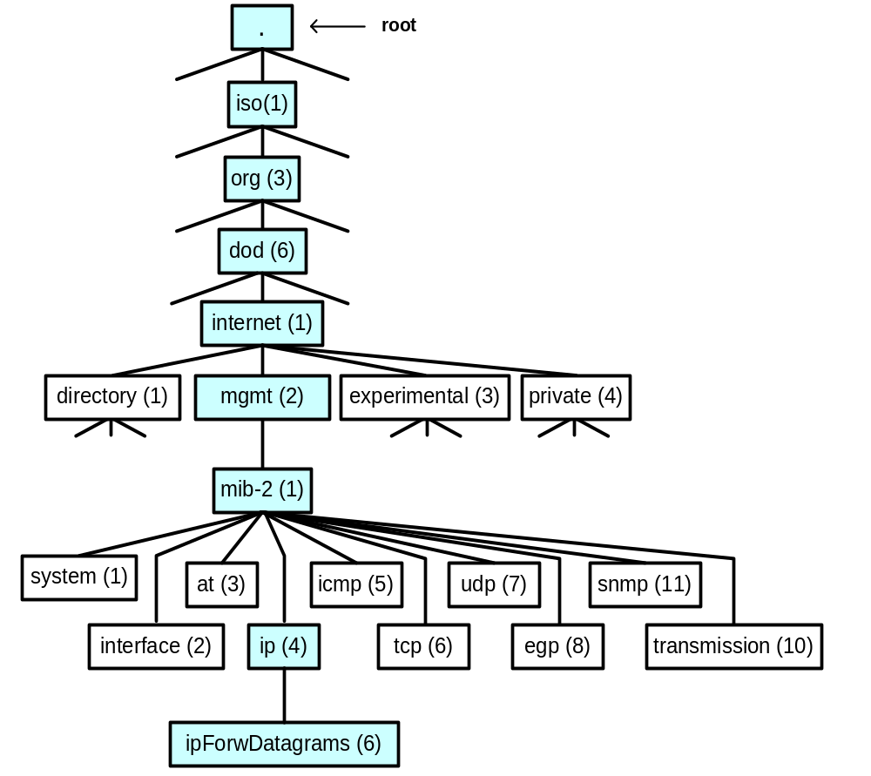
Organization of managed objects
Managed objects are organized in a tree-like hierarchy and the OIDs reflect the structure of the hierarchy.
Each OID represents a node in the tree.
The OID 1.3.6.1.2.1 (iso.org.dod.internet.mgmt.mib-2) is at the top of the hierarchy for all managed objects of the MIB-II.
Manufacturers of networking equipment can add product specific objects to the hierarchy.

Slide 26
SNMP – MIB
Object and Object identifiers
  Object is one of any number of specific characteristic of a managed device. Two type of object: Scalar and Tabular
  Object Identifier: uniquely identifies object in the MIB hierarchy.
  The top-level MIB object IDs belong to different standards organizations
  The lower-level object IDs are allocated by associated organizations

Slide 27
Oid and Full Oid
OID Tabular: tx(1) (indices: idCol1, idCol2)
idCol:1 | idCol:2 | idCol:3 | idCol:4 | …
1 | 4 | val1 | val11 | …
2 | 5 | val2 | val22 | …
3 | 2 | val3 | val33 | …
4 | 100 | val4 | val44 | …
5 | 5 | val5 | val55 | …
6 | 7 | val6 | val66 | …
.1.3.6.1.2.1 is path from root to tabular
Tabular tx Oid: .1.3.6.1.2.1.1
Oid of first column: .1.3.6.1.2.1.1.1
  Oid of value val44: .1.3.6.1.2.1.1.4.4.100

Slide 28

Q&A

